Slide 1
DOM Manipulation
Document Object Model

Slide 2
DOM
HTML DOM is a standard for how to
GET
CHANGE
ADD
DELETE

Slide 3
Hierarchy
Window object − Top of the hierarchy. It is the outmost element of the object hierarchy.
Document object − Each HTML document that gets loaded into a window becomes a document object. The document contains the contents of the page.
Form object − Everything enclosed in the <form>...</form> tags sets the form object.
Form control elements − The form object contains all the elements defined for that object such as text fields, buttons, radio buttons, and checkboxes.

Slide 4
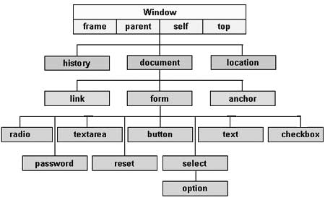
Hierarch graph

Slide 5
Types of DOM
The Legacy DOM − This is the model which was introduced in early versions of JavaScript language. It is well supported by all browsers, but allows access only to certain key portions of documents, such as forms, form elements, and images.
The W3C DOM − This document object model allows access and modification of all document content and is standardized by the World Wide Web Consortium (W3C). This model is supported by almost all the modern browsers.
The IE4 DOM − This document object model was introduced in Version 4 of Microsoft's Internet Explorer browser. IE 5 and later versions include support for most basic W3C DOM features.

Slide 6
DOM Browser Compatibility
if (document.getElementById) {
// If the W3C method exists, use it}
else if (document.all) {
// If the all[] array exists, use it}
else {
// Otherwise use the legacy DOM}

Slide 7
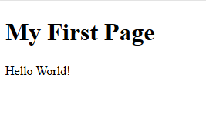
Basic DOM example
<html> <body> <h1>My Fist Page</h1>
<p id="demo"></p> <script> document.getElementById("demo") .innerHTML = "Hello World!"; </script> </body> </html>

Slide 8
DOM Features
List of features
https://www.w3schools.com/js/js_htmldom_document.asp

Slide 9
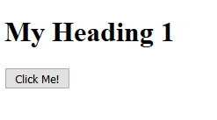
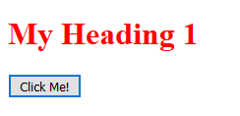
Element chage
<!DOCTYPE html>
<html>
<body>
<h1 id="id1">My Heading 1</h1>
<button type="button"
onclick="document.getElementById('id1').style.color = 'red'">
Click Me!</button>
</body>
</html>

Slide 10
Multiple IDs
<p id="p1">This is a text.</p>
<p id="p2">This is a text.</p>
<p id="p1">This is a text.</p>
<p id="p2">This is a text.</p>
<input type="button" value="Hide text" onclick="document.getElementById('p1').style.visibility='hidden'">
<input type="button" value="Show text" onclick="document.getElementById('p1').style.visibility='visible'">
The change will only affect the fist item in the list.

Slide 11
DOM Events
Reacts to user events
Common example
Submit button
When a user clicks the mouse
When a web page has loaded
When an image has been loaded
When the mouse moves over an element
When an input field is changed
When an HTML form is submitted
When a user strokes a key

Slide 12
<p>Click the button to display the date.</p>
<button onclick="displayDate()">The time is?</button>
<script>
function displayDate() {
document.getElementById("demo").innerHTML = Date();
}
</script>
<p id="demo"></p>

